Slide 1
Introducing Organization
Pre-Writing

Slide 2
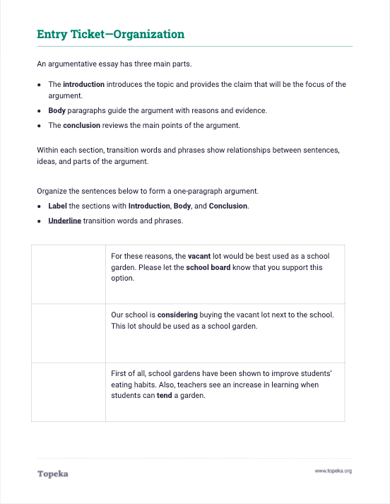
Entry Ticket
Complete the exercise to share what you know about organization.
2

Slide 3
What is an argument?
An argument is something we make to persuade others of our opinion or our position on an issue.
People make arguments to help others understand their ideas.
Notes:
“Today we’re going to be discussing the basic organizational structure of an argumentative essay. An argument is a position we take on something and all of the details we include to support that position.
When we make arguments, we’re trying to convince the reader to accept our position or take action. So we need to make sure that the argument is clear and well organized, in order for it to be effective.

Slide 4
Parts of an Argument
Arguments start with an introduction, which should contain a summary and the claim.
The body of the argument contains reasons and evidence to support the claim.
The argument ends with a conclusion, which recaps the main points of the argument.
Notes:
There are three basic parts to an argument: the introduction, body, and conclusion.
Arguments start with an introduction, which should contain a summary and the claim. The summary sums up the issue that you’re going to discuss, and the claim is your specific stance on that issue.
Next, the body of the argument contains reasons and evidence to support the claim.
After you’ve presented your reasons and evidence in the body, the conclusion recaps the main points of the argument.

Slide 5
Sample Outline
Introduction
Summary & Claim
Body
1st Paragraph
Reason, Evidence & Reasoning
2nd Paragraph
Reason, Evidence & Reasoning
3rd Paragraph
Reason, Evidence & Reasoning
Conclusion
Notes:
When you put these parts together into an outline, it looks something like this: The introduction comes first. Then come multiple body paragraphs, each focused on a reason supporting the claim. Finally the conclusion, which wraps up the argument.

Slide 6
Parts of an Argument: Introduction
The introduction tells what your argument is about.
A strong claim should be included in the introduction. The rest of the argument will focus on the claim.
Including a summary of the “ongoing issue” helps show that you understand the topic.
Notes:
Teacher will look more closely at each part of the argument.
Let’s look more closely at each of these parts.
Your writing should begin with an introduction, which tells what your argument is about.
Your intro must contain your claim, which is your stance on the issue. The rest of your argument should remain focused on the claim.
The introduction might also contain a summary of the ongoing issue or other information to help your reader understand the issue and become interested in what you have to say.
Teacher will ask students to share what paragraph from their entrance activity would be a part of the introduction.
In the entrance activity, which paragraph is the introduction?
“Our school is considering buying the vacant lot next to the school. This lot should be used as a school garden.” would be a part of the introduction in the argument. These sentences tell what the argument is about and introduce the writer’s claim on the topic: “This lot should be used as a school garden.”

Slide 7
Parts of an Argument: Body Paragraphs
Body paragraphs support the claim by presenting reasons, evidence, and an explanation of how the evidence connects to the claim. This explanation is your reasoning.
Notes:
Teacher will present explanation of body section.
The body of your essay is the biggest part of the argument.
Every paragraph of the body should be focused on supporting the claim with reasons and evidence. In addition, each paragraph should include an explanation of how the reasons and evidence connect to the claim. This explanation is your reasoning.
Teacher will ask students to share what paragraph from their Entry Ticket would be included in the body of an argumentative essay.
Returning to the entrance activity, what paragraph would be part of the body of this argument?
“First of all, school gardens have been shown to improve students’ eating habits. Also, teachers see an increase in learning when students can tend a garden.”
These sentences are the reasons for the writer’s claim that the vacant lot should be used for a school garden. A complete argument would contain evidence for each reason and reasoning to explain how it all connects together.
Also note that “first of all” and “also” are transition words that you might have underlined. They help connect the reasons in this paragraph.

Slide 8
Parts of an Argument: Conclusion
The conclusion is the end of your argument.
The conclusion should summarize the reasons you presented and restate your claim.
Notes:
Teacher will explain the elements of a conclusion within an argument:
Finally, your conclusion ends the argument. In your conclusion you should summarize what you’ve already said and give a closing thought.
Teacher will ask students to share what paragraph from their Entry Ticket would be a part of the conclusion.
In the Entry Ticket, what’s left to serve as the conclusion?
“For all these reasons, the vacant lot would be best used as a school garden. Please let the school board know that you support this option,” would be a part of the conclusion in the argument.
These sentences sum up the information used in the argument and also include a call to action for the audience.

Slide 9
Using Transition Words and Phrases
Transitions are word and phrases that help connect the ideas in your argument.
You can use transition words and phrases to make your ideas and organization clear to readers.
Notes:
Within these brief paragraphs of the Entry Ticket, there were words and phrases to help make the organization clear to readers. For example, in the sentence “For all these reasons, the vacant lot would be best used as a school garden,” the words ``For all these reasons” signals a transition into the conclusion of the essay.

Slide 10
Transitions serve many purposes.
To show
order
To present evidence
To show importance
First of all…
Next…
Finally…
For example…
According to…
Specifically…
Above all…
Mainly…
More importantly…
Surely…
To show an outcome
To compare ideas
To contrast ideas
Therefore…
For these reasons…
As a result…
Subsequently…
At the same time…
In the same way…
Likewise…
Similarly…
Though…
However…
Instead…
On the contrary…
On the other hand…
Notes:
Transitions help connect ideas in your argument, and they can serve many purposes
Teacher should refer to slide to offer examples of transition words.
Teacher will ask students to share the transition words or phrases that they underlined in their Entry Ticket.
What transition words did you identify in the entry ticket? Did these words help you understand how the argument should be organized?

Slide 11
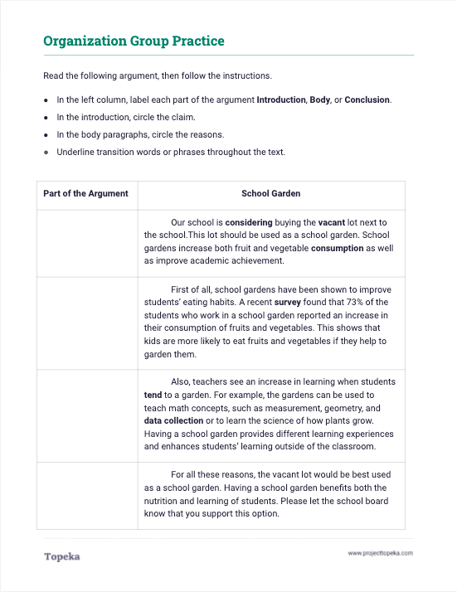
You do it together.
Work together to identify the organization used in the model.
11
Notes:
Teacher will separate students into pairs or small groups and provide instructions:
In your group, you will read the argument and then follow the instructions. You will be labelling each paragraph with Introduction, Body, or Conclusion. You’ll circle the claim within the introduction and the reasons in the body. And you’ll underline the transition words that connect everything together.
Teacher will reconvene class to debrief the group activity.
When asking students to describe transition words they found, teacher should ask students to describe purpose of each transition word. Display slide 10 again if necessary.

Slide 12
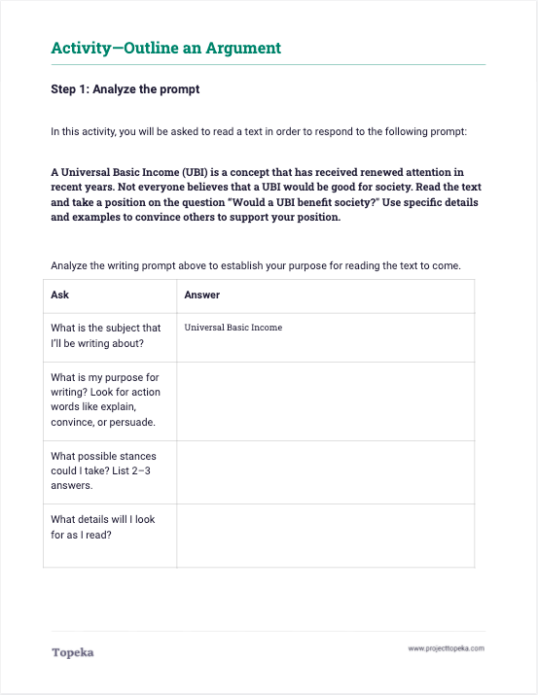
Independent Application
Complete the activity to show how you would respond to the prompt.
12
Notes:
Teacher will distribute the outlining activity and will instruct students to independently plan an argument responding to the prompt: Would a A Universal Basic Income benefit society?
Now we’re going to work independently to outline an argument in response to text and prompt. There are three steps to this activity.
First, read the prompt and answer questions to make sure you understand.
Next, read the text to gather information for your argument.
Finally, build the outline for your argument.
In your outline, you do not need to write complete sentences. Just indicate with a few words what you would include in each part of the argument. Imagine that you could later take this outline and use it as a guide to write your actual argumentative essay.

