Slide 1
Reading Closely to Make Arguments
Pre-Writing

Slide 2
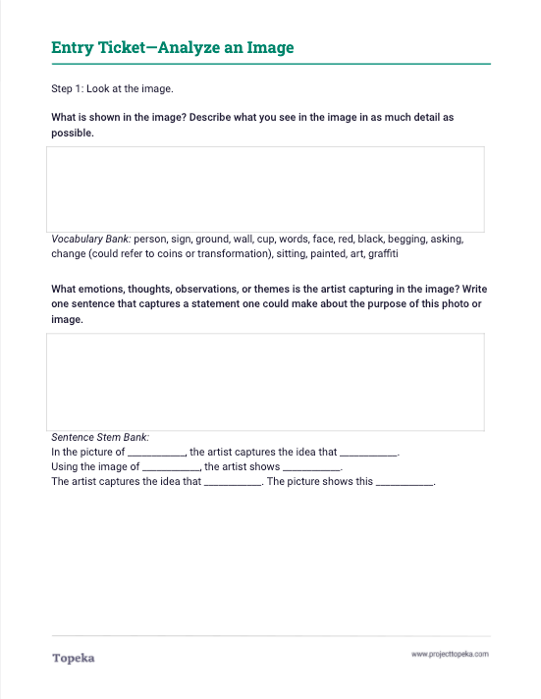
Analyze the image.
Complete the entry ticket using the photo provided.
2

Slide 3
What argument is the artist trying to make?
3

Slide 4
What argument is the artist trying to make?
“The man in the picture looks homeless, because he is on the ground holding a sign.”
4
Notes:
Teacher models the process of looking for details in order to make meaning. Sample script:
"What is the artist trying to convey with this picture? I am going to do a think-aloud so you can hear how I look for details when I start making meaning.
“I am noticing the man in the picture looks homeless, because he is on the ground holding a sign.” Can you help me find another detail that helps me understand the work of art?”

Slide 5
What argument is the artist trying to make?
We Do It Together
5
Notes:
Teacher calls on students in large group and asks students to make a claim about the argument that the artist is trying to make.
“What else do you see in this picture? What other details support this idea? Can you make a different argument about the artist’s intent?”
Teacher asks students to support their answers using details from the photo and to explain how the detail suggests that meaning.
Teacher models the necessity of both the detail and the explanation.

Slide 6
What argument is the artist trying to make?
For example: “The artist is arguing that the small efforts people make to help fix society’s problems, like homelessness, aren’t enough. In the picture, the man is seated on the ground and wrapped in blankets, suggesting that he is homeless. He has his cup out in front of him, asking for help. But his sign says “Keep Your Coins, I want change,” which suggests that what he really wants is a change in society, and not people’s pocket-change.”
6
Notes:
Teacher models.
Here is a complete argument about the image: “The artist is arguing that the small efforts people make to help fix society’s problems, like homelessness, aren’t enough. (This is the claim) In the picture, the man is seated on the ground and wrapped in blankets, suggesting that he is homeless. He has his cup out in front of him, asking for help. But his sign says “Keep Your Coins, I want change,” (these are details) which suggests that what he really wants is a change in society, and not people’s pocket-change. (This is the explanation)”

Slide 7
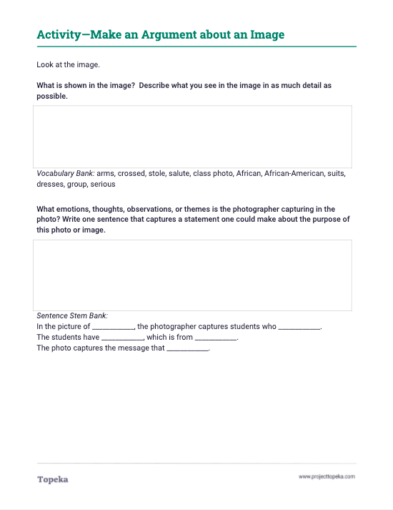
You do it together.
Collaborate to find evidence for an argument about a new photo.
7
Notes:
Teacher distributes second handout and sets expectations for students to collaboratively analyze another photo.

Slide 8
What is the argument of this photo?
Notes:
Teacher displays or distributes image for analysis.

Slide 9
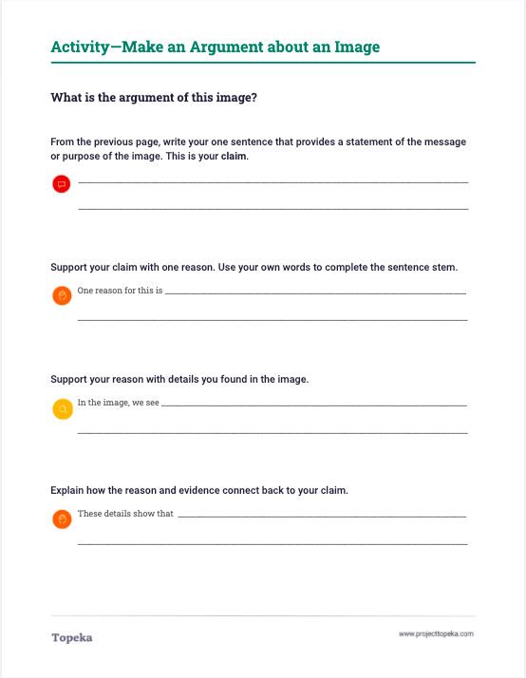
Independent Practice
Use the details you found in your analysis to build an argument.
9
Notes:
Teacher instructs students to use sentence stems provided on the third page of handout to build an argument about the image: write a claim and support it with at least one reason and one piece of evidence.

