Slide 1
Claim and Focus
Intervention Lesson

Slide 2
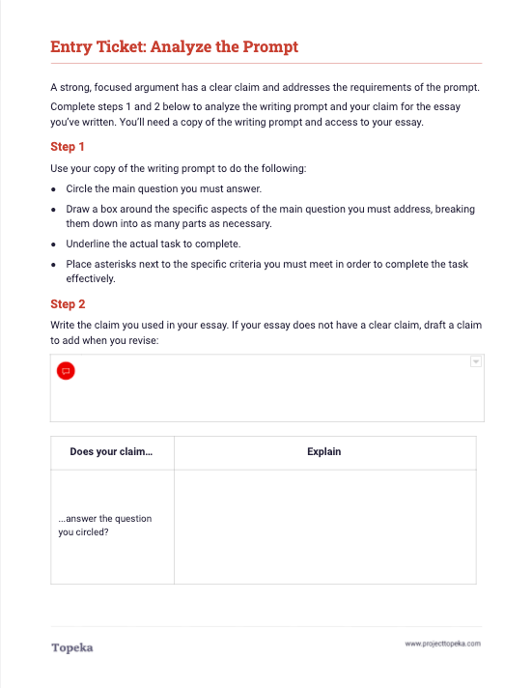
Entry Ticket
A strong, focused argument has a clear claim and addresses the requirements of the prompt. Analyze the prompt and your claim. Then discuss your answers with a classmate.
2
Notes:
After students complete activity:
Take a moment to talk to your neighbor about the main question you circled in the writing prompt. Explain to your partner how your claim answers the question—or how you think you might change your claim to make it answer the question.

Slide 3
In this lesson, you will learn…
what a claim is
why understanding the prompt helps you write a strong claim
how to revise your claim to improve your essay’s claim and focus
Notes:
Today we are going to revisit the concept of writing a strong claim to improve the essay you’ve already written. You’ve just completed an entry ticket that had you analyze the writing prompt you used to write your essay. We’ll talk briefly about claims and then you’ll each plan a revision to see if you can improve the claim and focus of your essay.

Slide 4
What is a claim?
Your claim is your position on an issue. When you make an argument, you’re trying to convince readers to accept your claim.
In academic situations, you often can think of your claim as your answer to the main question of the writing prompt.
Notes:
Let’s revisit the idea of making a claim. Your claim is your position on an issue or question. When you’re making an argument, you’re trying to convince readers to accept your claim.
Think of your claim as your answer to the main question posed in the writing prompt, boiled down into one statement.

Slide 5
Summary and Claim
Reason
Evidence
Reasoning
The rest of your argument should be focused on supporting your claim.
Reason
Evidence
Reasoning
Reason
Evidence
Reasoning
Conclusion
Notes:
The rest of your argument should be focused on the claim.
Each of your reasons will provide support for the claim. You’ll prove your reasons are valid using evidence from the text. And you’ll explain how your evidence supports your reasons and connects to the claim. This explanation is your reasoning.
It's much easier to write good support when you have a good claim.

Slide 6
What makes a strong claim?
A strong claim is…
Clear
Specific
Arguable
Readers understand what your position or answer is.
It is narrow enough to indicate what your particular focus
will be.
You are making a statement that could have an equally valid alternate or opposing position.
Notes:
So what makes a strong claim? A strong claim is clear, specific, and arguable.
When your claim is clear, readers understand what your position or answer is.
When your claim is specific, it is narrow enough to indicate what your particular focus will be.
When your claim is arguable, you are making a statement that could have an equally valid alternate or opposing position. That means someone else could reasonably disagree with your stance.

Slide 7
Writing a strong claim begins with understanding what the prompt is asking.
What is the main question you must answer?
What specifics help narrow the focus of your answer? Are there particular aspects of the topic that must be addressed?
What is the task?
What additional criteria for performing the task are required?
Making a Strong Claim
Notes:
A strong claim is also answering the question posed in the prompt. And so, it’s really important for you to understand the question. In order to know if you are answering the question, you must start by understanding the prompt.
What is the main question you must answer?
What specifics help narrow the focus of your answer? Are there particular aspects of the topic that must be addressed?
What is the task?
What additional criteria for performing the task are presented?
These questions are the questions you answered when you did your prompt analysis in the entrance activity.

Slide 8
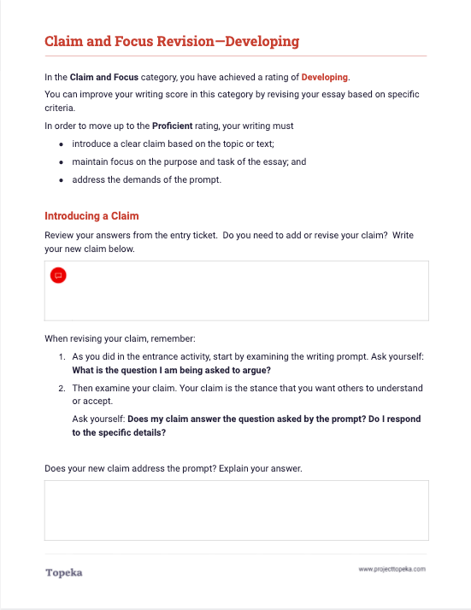
Improve Your Claim
Use the analysis you did in the entry ticket along with the revision instructions to strengthen your claim and improve the focus of your essay.
2
Notes:
Teacher leads class through a debrief of the prompt analysis from the entry ticket, asking students to contribute what they circled, boxed, underlined, and asterisked.
Teacher prepares students for activity presented in next step.
In a moment you will receive instruction to help you plan a revision of your essay. As you read the instructions and revise your claim, keep in mind what you learned from the prompt analysis.

