Slide 1
Language and Style
Intervention Lesson

Slide 2
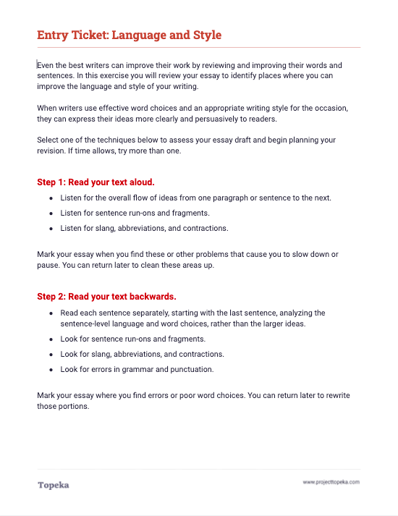
Entry Ticket
Use the entry ticket to identify places you may need to revise language and style.
2
Notes:
The first two steps of the entry ticket can be completed individually. Step 3 of the entry ticket invites students to roleplay with a peer. Teacher should invite students to pair with a classmate to complete this portion.
When you’re finished analyzing your essay, turn to a neighbor and follow the instructions for roleplaying with a peer.

Slide 3
In this lesson, you will learn…
what is formal and informal style
what is word choice
how to revise for sentence structure
Notes:
Teacher presents learning objectives for session:
In the activity you just completed, you carefully read your essay to determine where and how you might make improvements to the choices you’ve made that affect language and style.
Today, we’re going to talk a little bit about formal and informal style; what we mean by word choice and choosing words to enhance style; and what we mean when we talk about revising sentence structure. Then you’ll each work on revising your essay’s language and style..

Slide 4
What is an audience?
Your audience is the group of people to whom you are presenting your argument.
The language and style of your argument should be chosen to appeal to your audience.
In academic writing, you should use a formal style.
Notes:
Teacher will introduce the concept of an audience for an argument. Sample script:
When you’re making an argument you’re trying to convince someone to accept your claim. That “someone” is your audience, the people to whom you’re presenting your argument.
Teacher asks students to name audience for a few different arguments. For example,
“You are arguing for a longer lunch period—who would your audience be?”
“You’re arguing to determine what movie to see this weekend—who is your audience?”
“You’re arguing for a raise at a job—who is the audience?”
The style you use to present your argument will affect how successful you are in convincing your audience that you should be believed. In academic writing, you should use a formal style.

Slide 5
Style is seen in the choices a writer makes about vocabulary, sentence structure, and organization.
Formal
Informal
What is formal and informal style?
Formal style is the use of impersonal, objective, and precise language.
“When people buy their food from local sources, they support farmers and producers in their area. The food is likely to be fresher because it can reach consumers more quickly.”
Informal style uses conversational, subjective, or slang language.
“I think that it’s best to buy food from local sources. You can meet local farmers, and you know the food is fresh.”
Notes:
Teacher begins discussion of differences between formal and informal style.
Formal and informal style is seen in the choices a writer makes about words, sentence structure, and organization. Again, your writing for school should always use formal style.
When it comes to word choice, formal style is the use of impersonal, objective, and precise language.
Informal style uses conversational, subjective, or slang language.
Teacher reads the formal and informal examples.
In the formal example, the writer is less personal, and states the ideas as truths, rather than opinions or observations..
The informal example is conversational and subjective, using “I think” and “you can.”

Slide 6
Formal word choices are
grammatically correct;
polite;
technical and precise;
full words, not contractions or abbreviations; and
not slang.
How does formal style affect word choice?
Notes:
Teacher continues to discuss how formal style is seen in word choices.
Formal style is
grammatically correct; choices follow standard conventions of language, grammar, and punctuation;
polite—it does not use derogatory terms or insult the reader;
technical and precise (for example, in science, you’d use technical words like “beaker,” rather than non-technical words like “glass container”);
full words, not contractions or abbreviations; avoid don’t, isn’t, doesn’t, and the like (no emojis and no texting language); and
not slang
With an informal style of writing, a writer or speaker has fewer rules to follow. The writer's choice of words could be more casual and conversational, and can break these rules. Sometimes in informal writing, writers make deliberate choices that don't follow grammatical rules.

Slide 7
Precise words convey ideas more clearly than vague or basic choices:
Vague: “It was so cold last night.”
Precise: “The temperature dipped below 0°C last night.”
Vivid verbs can make ideas more apparent and add meaning:
Basic Verb: “After the news, their number of followers decreased.”
Vivid Verb: “After the news broke, their number of followers plummeted.”
How does formal style affect word choice?
Notes:
Teacher continues to discuss benefits of careful word choice:
There are other ways in which formal word choices strengthen our writing. For example,
Precise words convey ideas more clearly than vague or basic choices. Let’s look at these examples:
Vague: “It was so cold last night.”
Precise: “The temperature dipped below 0°C last night.”
Teacher continues:
Let’s see if we can rewrite a sentence to use formal precise language: “There are a lot of kids at our school.” Who can make that sentence more precise?
Teacher pauses to allow contributions from the class. A precise version might be, “There are 1,245 students at [your school name].”
In addition, vivid verbs can make ideas more apparent and add meaning. Let’s look at the examples:
Basic Verb: “After the news, their number of followers decreased.”
Vivid Verb: “After the news broke, their number of followers plummeted.”
Let’s see if we can rewrite a sentence to use more vivid verbs: “The garden grew.” Who can think of some more vivid verbs that would convey how the garden grew?
Teacher pauses to allow contributions from the class. Some possible vivid verbs might be “exploded with color” or “burst into life.” Ask students to offer examples from their own writing where they may be able to choose more vivid verbs.

Slide 8
Informal and Formal Word Choices
Informal Word Choice
Formal Word Choice
“Saying that food is salty, sweet, or bitter is pretty run-of-the-mill. There’s another word that I like a lot: umami. Lots of foods have umami, like fish, cheese, and mushrooms. Foods that have lots of umami are yummy!”
“Words like salty, sweet, or bitter are used often to describe the taste of food. A word that is used less frequently is umami, which describes the meaty or brothy flavor present in foods like fish, cheese, and mushrooms.“
Notes:
Teacher presents another revision for word choice and asks students to identify how and why the passage was revised.
Let’s read these two examples to see how the writer revised to use more formal word choices.
Teacher asks student to read the informal passage, and then asks another student to read the more formal passage. Teacher asks for students to explain what changes were made and why they were made. Provide assistance as needed:
Edited to remove subjective language (“I like,” and “yummy”)
Edited to be less conversational and more informational (“pretty run-of-the-mill” vs “used often”)
Edited to use more technical language (no description vs “meaty or brothy flavor”)

Slide 9
Formal sentence structures use
complete sentences;
varied sentence beginnings; and
mix of simple, compound, and complex sentences.
How does formal style affect sentence structure?
Notes:
How does formal style affect sentence structure? Writing that lacks sentence variety can feel repetitive, choppy, or difficult to read. When we use sentence variety effectively, the writing forms an engaging and pleasing rhythm.
Formal sentence structures use
complete sentences;
variety in the way sentences start; and
a mix of simple, compound, and complex sentences
With an informal style of writing, a writer or speaker would again have fewer rules to follow. The writer's sentence structure might be more fragmented, casual and conversational, and might include run-ons and other grammatically incorrect structures.

Slide 10
Revising Sentence Structure
Original Simple Sentences
Revised Sentence Structure
“The chef started chopping onions. She scooted them to the side. She chopped carrots and celery next. She poured oil into the pan. She turned on the stove. She dumped the chopped vegetables into the pan.”
“The chef chopped the onions, scooting them to the side before starting on the carrots and celery. She then poured oil into the pan. After turning on the stove, she dumped the chopped vegetables into the pan.”
Notes:
Teacher asks students to read original and revised sentences shown on slide. Then teacher asks for volunteers to explain the revisions, providing assistance as necessary.
In the original sample, every sentence is a simple sentence: one subject and one predicate. We can see that in the revised sentences, the writer has combined the first three original sentences into a single complex sentence. Then there is a simple sentence, with a transition word added to show sequence “She then poured oil into the pan.” Finally the last two original sentences become one.

Slide 11
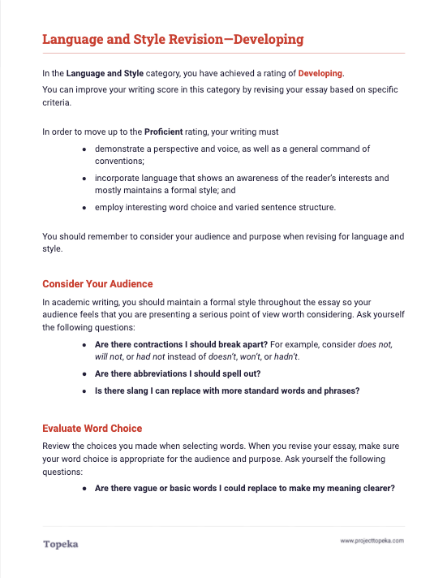
Revision Activity
Use your marked-up draft from the entry ticket and the revision instructions to plan your revision. Then revise your essay to improve its language and style.
2
Notes:
Teacher passes out revision activities according to student performance on the automated scoring. Teacher presents revision activity:
Now, with this basic understanding of formal and informal style, using your entry ticket analysis and the instructions in your revision handout, you should plan a revision to improve your score. Let’s get started.
Teacher will circulate to provide assistance as students plan and revise their essays.

