Slide 1
Organization
Introducing Exemplars

Slide 2
Revising an Exemplar Essay
What will you see in this exemplar lesson?
Draft
Strategies
Revision
A sample first draft of an essay
Specific actions a writer can take to improve the organization of a draft
A sample revision of the exemplar essay using action steps
Notes:
Teacher will set the purpose for the lesson by describing what students will encounter:
In this lesson, we’re going to look at the process of revising an essay to improve performance in the organization domain.
First, we will look at a sample first draft alongside the revision strategies for this domain. You will use the strategies sheet to make suggestions for improving the sample first draft.
Then, we’ll look together at specific revision steps a teacher suggested for this essay, and we’ll try to implement those steps for the sample essay.
Finally, we’ll see a sample revision to see how the writer used those specific action steps to improve the organization of the draft.

Slide 3
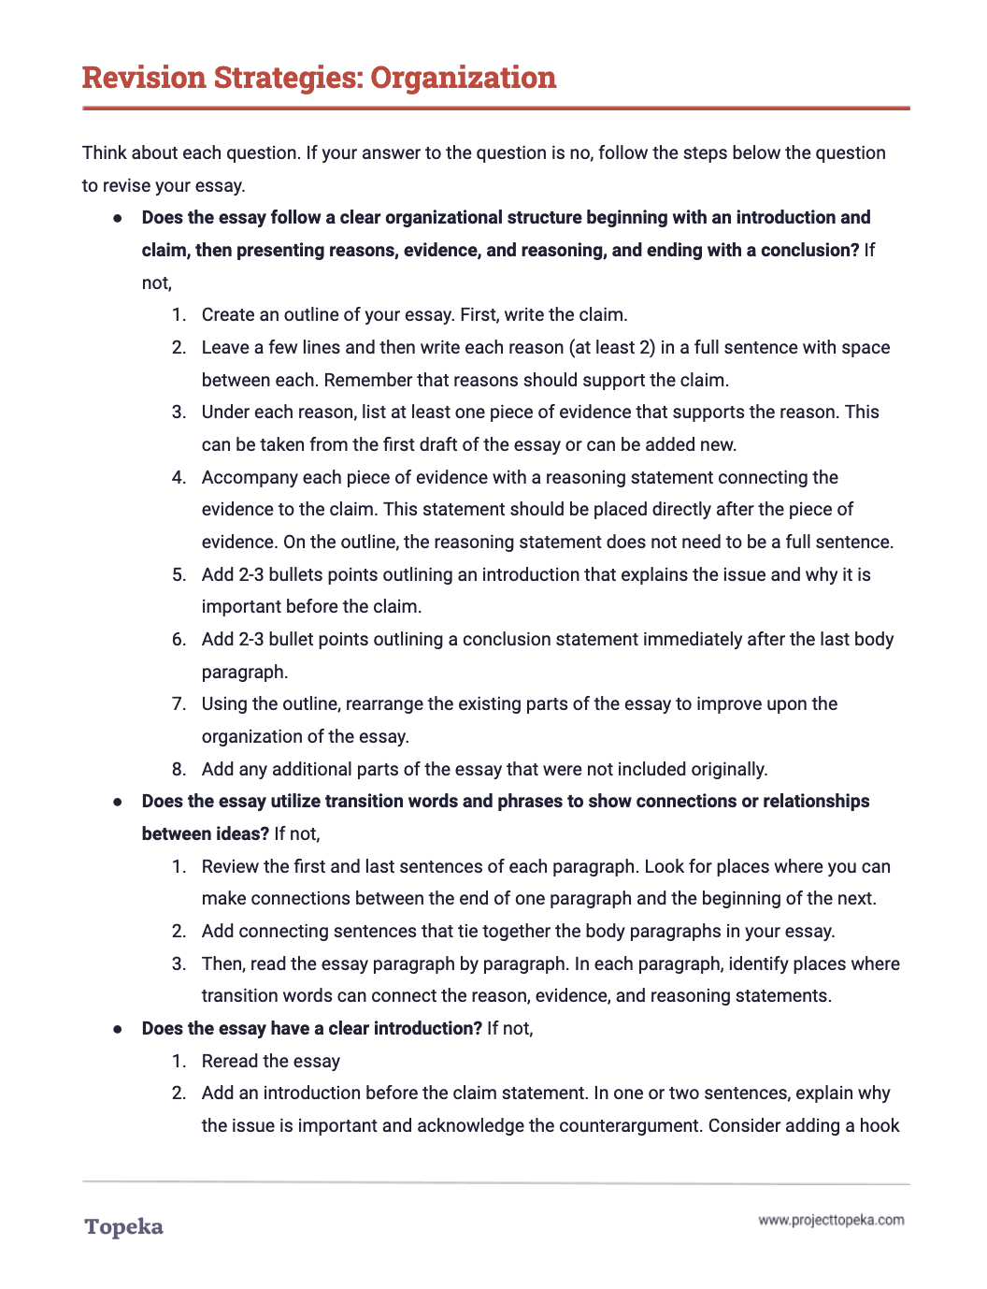
Revision Strategies: Organization
Review the revision strategies sheet for organization.
2
Notes:
Teacher distributes Revision Strategies: Organization.
Take a moment to review the revision strategies sheet for organization. Think back to what you know about organization -- how strong arguments are organized.
Teacher has students Pair and Share with a classmate to confirm their understanding of what organization means and how it is evaluated.
Teacher distributes the handout Organization Exemplar: Before Revision. Teacher directs students to look at the first page.
Here is an example of a student writing about school uniforms. The question the student is answering is whether or not school uniform policies and dress codes violate students' rights and undermine important values.
Using the revision strategies for organization, suggest revisions that would strengthen the writer’s achievement in the organization domain. For this exercise. concentrate on the strategies provided at the “developing” level. Annotate the draft to show your suggestions and your explanation.
When students complete the review, teacher has students partner with others to compare the suggested changes. Have students explain their suggestions:
How do these changes increase student achievement on the organization section of the rubric? Why do you think the revised essay will be better?

Slide 4
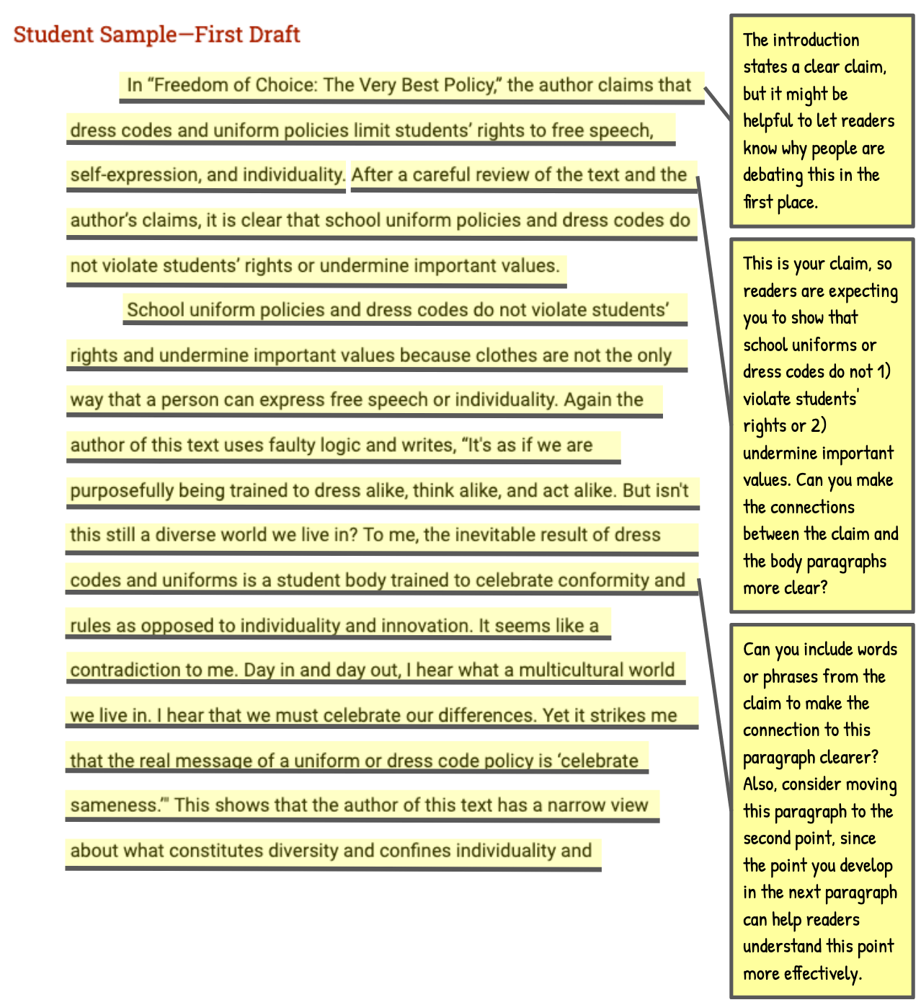
Exemplar First Draft
Review the suggested changes.
Notes:
Teacher directs students to the second page of the Organization Exemplar: Before Revision handout and explains the annotations.
After reviewing this piece of writing, I can see that there is a basic organization structure to this essay, but the introduction and conclusion could be improved to provide better framing of the body paragraphs, and the progression of reasons in the body paragraphs could be stronger.
If I look at the revision strategies sheet, I can use questions to help me identify revision strategies. “Does the essay follow a clear organizational structure beginning with an introduction and claim, then presenting reasons, evidence, and reasoning, and ending with a conclusion?” I can see that creating or revisiting an outline with the parts of the essay can help make the organization clear and easier to evaluate. Once I see the structure, I can make sure the progression is as strong as it can be.
“Does the essay have a clear introduction?” “Does the essay have a clear conclusion?” Looking at the essay, I notice that the first paragraph is the introduction and the last paragraph is the conclusion. Both paragraphs could be improved.
In between are two body paragraphs. Another question I can ask myself is “Is the order of the evidence and reason paragraphs based on the strength of the arguments?” Looking at the outline, I see that the first body paragraph provides the reason that clothes aren’t the only way for students to express themselves, and the second paragraph is about uniforms and dress codes promoting good judgement and consideration of others. I think changing the order could strengthen the essay.
Using the annotated first draft, teacher will continue to review the suggested changes, ask students to evaluate their impact, and also answer questions related to the domain’s evaluation criteria:
Do you think these suggestions will help improve organization? Where else do you think the writer could improve the organization? What other suggestions do you think would help this essay and why would these changes improve the organization?

Slide 5
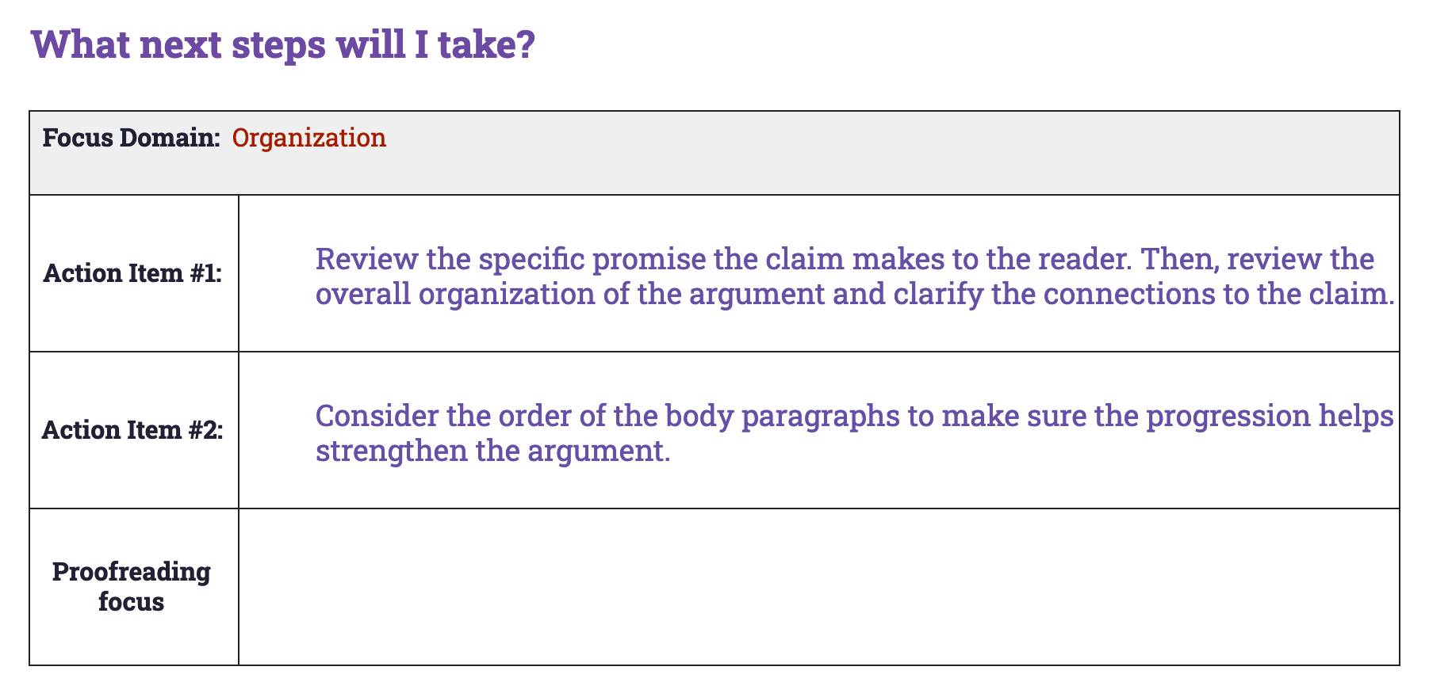
Sample Conference Record
Notes:
Teacher describes how a conference record is used to convey suggested revisions:
Here is an example of a conference record conveying the same strategies the teacher suggested in the annotations.
Teacher continues:
In the top row, we see that the writer is going to concentrate on the organization of the essay. Let’s look at again at the revision steps provided to this writer:
The first step is to review the claim and the overall organization to make sure everything is connected.
The second step is to consider the order of the reason paragraphs to make sure the progression is strong—in other words, that the order helps the argument.
Another possible revision is to develop the introduction and conclusion further to show why the issue is important. Developing these parts of the essay will make their purpose in the structure of the essay clearer to readers.
Which two would you choose to focus on?
Teacher directs students to work in small or large groups to review the recommendations and discuss the impact of these revisions. If time allows, students can implement the suggested revisions.

Slide 6
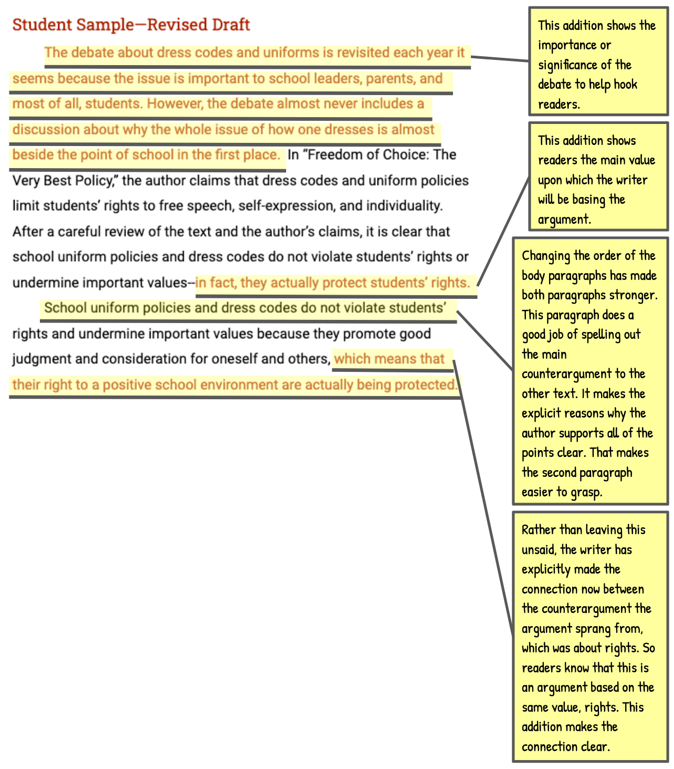
Exemplar Revision
Assess the writer’s revisions.
Notes:
Teacher distributes the Organization Exemplar: After Revision and directs students’ attention to the first page of the revised essay.
In this revised draft, the writer has responded to the action steps the teacher presented in the conference form. This draft models all three possible revisions so you can see how each could be addressed. Review these revisions to see if you understand their impact. Follow the instructions on the handout.
Teacher allows students time to read revised essay and react to the revisions.
Teacher directs students to turn attention to the revised essay. Teacher thinks aloud to describe impact of revisions.
What do you notice about the differences in this text based on the highlighted sentences? How have these changes strengthened the essay’s organization?
If you read the sentences highlighted in red, you will see the changes the writer made in response to the teacher’s annotations and action steps. For example, in the introduction, the addition of two sentences introduces the issue that the essay is going to discuss, which flows nicely into the sentence presenting the argument of the source text, which then flows nicely into the writer’s own claim. This is now clearly an introduction that will help structure the rest of the argument.
Similarly, by changing the order of the reason paragraphs in the body and adding additional language to connect the reasons back to the claim, the writer has strengthened both of those support paragraphs.
Teacher continues to describe revisions using annotations on revised sample.
Teacher concludes by reminding students to apply revision strategies to their own essays.
When you’re revising your essay, remember to use these helpful revision strategies to take your essay to the next level.

